Slide 1

LECTURE No.2
INTRODUCTION TO BRIDGE ENGINEERING

Slide 2
LECTURE No.2 (TOPICS)
References:
Bakht and Aftab A. Mufti
AASHTO (LRFD 1994)
PCPHB
AASHTO Standard Specifications
Loads:
    Gravity Loads
    Lateral Loads
    Forces due to deformation
    Collision Loads
Development of Design Procedures
ASD and LRFD Design Philosophies
      Continued…

Slide 3
LECTURE No.2 (TOPICS)
Limit States:
    Service Limit State
    Strength Limit State
    Fatigue and Fracture Limit State
    Extreme Event Limit State
Principles of Probabilistic Design
Geometric Design Considerations
Relevant Portions of AASHTO And PCPHB

Slide 4
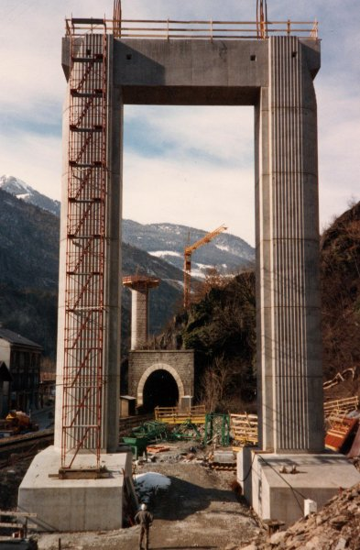
LOADS

Slide 5
INTRODUCTION
Some Basic Definitions:
Load: It is the effect of acceleration, including that due to gravity, imposed deformation or volumetric change.
Nominal Load: An arbitrary selected design load level.
Load Factor: A coefficient expressing the probability of variations in the nominal load for the expected service life of the bridge.
Permanent Loads: Loads or forces which are, or assumed to be, constant upon completion of construction.
Force Effects: A deformation or a stress resultant, i.e., thrust, shear, torque/or moment, caused by applied loads, imposed deformation or volumetric changes.

Slide 6
IMPORTANCE OF LOAD PREDICTION
A structural engineer has to make a structure safe against failures.
The reasons for a structure being susceptible to failures are:
    The loads that a structure will be called upon to sustain, cannot be predicted with certainty.
    The strength of the various components cannot be assessed with full assertion.
    The condition of a structure may deteriorate with time causing it to loose strength.

Slide 7
TYPES OF LOADS
Loads considered in Bridge analysis are:
    Gravity Loads
    Lateral Loads
    Forces due to deformation
    Collision Loads

Slide 8
GRAVITY LOADS
    Gravity loads are the loads caused by the weight
    of an object on the bridge and applied in a
    downward direction toward the center of the
    earth. Such loads may be:
      Permanent Gravity Loads
      Transient Gravity Loads

Slide 9
A. Permanent Gravity Loads
    Permanent gravity loads are the loads that remain on the bridge for an extended period of time or for the whole service life.
    Such loads include:
        1. Dead load of structural components and non structural attachments --------------------------------------- (DC)
        2. Dead load of wearing surfaces and utilities --- (DW)
        3. Dead load of earth fill ---------------------------- (EV)
        4. Earth pressure load ------------------------------- (EH)
        5. Earth surface load --------------------------------- (ES)
        6. Downdrag ------------------------------------------ (DD)

Slide 10
A. Permanent Gravity Loads
    DEAD LOAD OF STRUCTURAL COMPONENTS
    AND NON-STRUCTURAL ATTACHMENTS (DC)
    In bridges, structural components refer to the elements that are part of load resistance system.
    Nonstructural attachments refer to such items as curbs, parapets, barriers, rails, signs , illuminators, etc. Weight of such items can be estimated by using unit weight of materials and its geometry.
    Load factors per table A3.4.1-1 and A3.4.1-2 apply here. (From AASHTO LRFD 1994 Bridge Design Specifications).

Slide 11
A. Permanent Gravity Loads
    DEAD LOAD OF WEARING SURFACES AND UTILITIES (DW)
      This load is estimated by taking the unit weight times the thickness of the surface.
      This value is combined with the DC loads per table A3.4.1-1 and A3.4.1-2 (From AASHTO LRFD Bridge Design Specifications).
      The maximum and minimum load factors for the DC loads are 1.25 and 0.90 respectively and for DW loads are 1.5 and 0.65 respectively .

Slide 12
A. Permanent Gravity Loads
        DEAD LOAD OF EARTH FILL (EV)
        This load must be considered for buried structures such as culverts.
        It is determined by multiplying the unit weight times the depth of the materials.
        Load factors per table A3.4.1-1 and A3.4.1-2 apply here. (From AASHTO LRFD Bridge Design Specifications).
        EV has a maximum and minimum load factor of 1.35 and 0.9 respectively.

Slide 13
A. Permanent Gravity Loads
        EARTH SURFACE LOAD (ES)
        The earth surcharge load (ES) is calculated like the EV loads with the only difference being in the load factors.
        This difference is attributed to the variability.
        Part or all of this load could be removed in the future or the surcharge material (loads) could be changed.
        ES has a maximum and minimum load factor of 1.5 and 0.75 respectively.

Slide 14
A. Permanent Gravity Loads
        DRAGDOWN (DD)
        It is the force exerted on a pile or drilled shaft due to the soil movement around the element. Such a force is permanent and typically increases with time.
        Details regarding DD are outlined in AASHTO (LRFD 1994) Section 10, Foundations.

Slide 15
B. Transient Gravity Loads
        As the name implies these loads change with time and may be applied from
        several directions or locations.
        Such loads are highly variable.
        Transient loads typically include gravity load due to the vehicular, rail or
        pedestrian traffic as well as lateral loads such those due to wind, water, ice, etc.
        Engineer should be able to depict…
        ____ which of these loads is appropriate for the bridge under consideration
        ____ magnitude of the loads
        ____ how these loads are applied for the most critical load effect.

Slide 16
B. Transient Gravity Loads
        For transient load each code has described the following criterion:
        Design lanes
        Vehicular Design loads
        Fatigue Loads
        Pedestrian Loads
        Deck and Railing Loads
        Multiple Presence
        Dynamic Effects
        Centrifugal Forces

Slide 17
DESIGN LANE
        Number of lanes a bridge may accommodate must be established.
        Two such terms are used in the lane design of a bridge:
        Traffic lane
        Design Lane.
        Traffic Lane:
        The traffic lane is the number of lanes of traffic that the traffic engineer plans to route across the bridge. A lane width is associated with a traffic lane and is typically 3.6 m.
        Design Lane:
        Design lane is the lane designation used by the bridge engineer for the live load placement.
        The design lane width may or may not be the same as the traffic lane.

Slide 18
DESIGN LANES
According to AASHTO specifications,
    AASHTO uses a 3m design lane and the vehicle is to be positioned within that lane for extreme effect.
    The number of design lanes is defined by taking the integral part of the ratio of the clear roadway width divided by 3.6m.[A3.6.1.1.1]
    The clear width is the distance between the curbs and/or barriers.

Slide 19
VEHICULAR DESIGN LOADS
  A study by the transportation Research Board (TRB) was used as the basis for the AASHTO loads TRB (1990).
  Loads that are above the legal weight and are /or length limits but are regularly allowed to operate were cataloged. Those vehicles that were above legal limits but were allowed to operate routinely due to grandfathering provisions are referred to as ‘Exclusion Vehicles’.
  These exclusion trucks best represents the extremes involved in the present truck traffic.
  For analysis, simpler model was developed which represents the same extreme load effects as the exclusion vehicles.
This model consists of three different loads:
1.Design truck
2.Design tandem
3.Design Lane

Slide 20
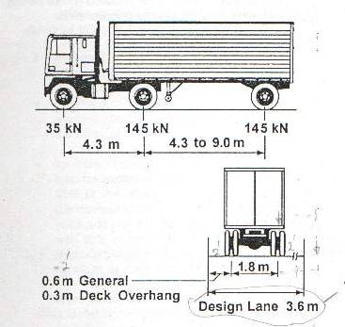
VEHICULAR DESIGN LOADS
Design Truck:
According to AASHTO design specifications(1996), the design truck is a model that resembles the semitrailor truck. as shown in the figure.[A3.6.1.2].
Variable Spacing
The variable spacing provide a more
satisfactory loading for continuous
spans and the heavy axle loads may
be so placed on adjoining spans as to produce maximum –ve moments.
This design truck has the same configuration since 1944 and is commonly referred to as HS20-44(denoting Highway Semitrailer 20 tons with year of publication 1944).

Slide 21
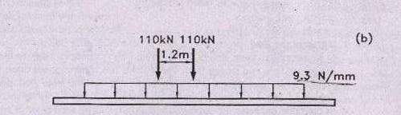
DESIGN TANDEM
The second configuration is the design tandem and is illustrated in the figure.It consists of two axles weighing 110kN each spaced at 1.2m.
TANDEM: A tandem can be defined as two closely spaced and mechanically interconnected axles of equal weight.

Slide 22

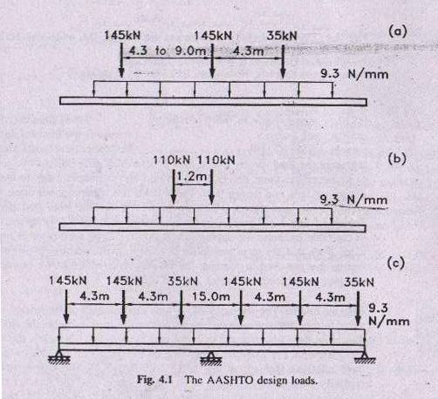
DESIGN LANE LOAD
The third load is the design lane load that consists of a uniformaly distributed load of 9.3 N/mm and is assumed to occupy a region 3m transversly. This load is same as uniform pressure of 64 lbs/ft² applied in a 10ft (3m) design lane.
The load of design truck and design tandem must each be superimposed with the load effects of the design lane load. This combination of load and axle loads is a major deviation from the requirements of the earlier AASHTO standard specifications where the loads were considered separately.

Slide 23
COMPARISON OF HS20 & PRESENT TRAFFIC
Kulicki and Mertz(1991) compared the load effects (shear and moments) for one and two span continuous beams for the previous AASHTO loads and those presently prescribed.
In their study, the HS20 truck and lane loads were compared to the maximum load effect of 22 trucks representative of today's traffic. The ratio of the maximum moments and shear to the HS20 moments is illustrated in figure.

Slide 24
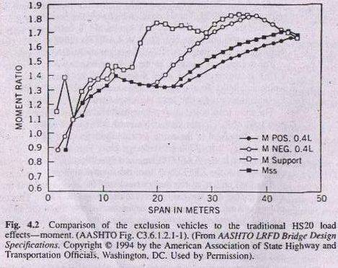
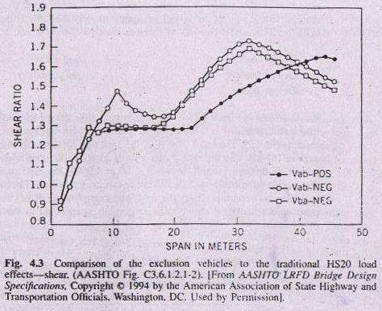
COMPARISON OF HS20 & PRESENT TRAFFIC
In the figure there is significant variation in the ratios and most ratios are greater than 1, indicating that the exclusion vehicle maximums are greater than the model load, a nonconservative situation.

Slide 25
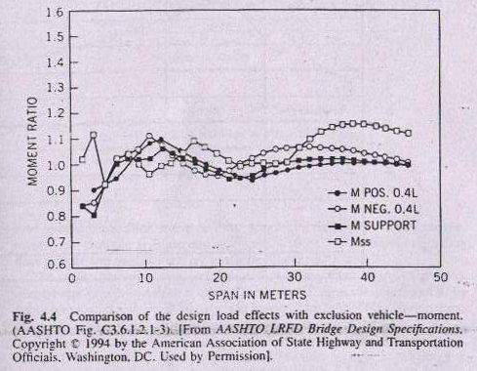
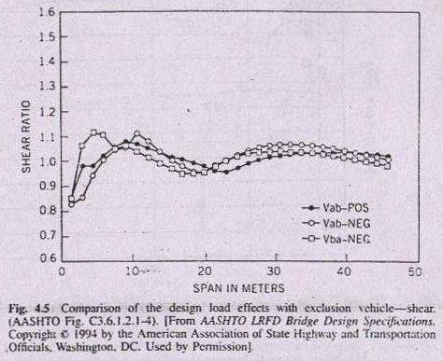
COMPARISON OF HS20 & PRESENT TRAFFIC
A perfect model would contain ordinates of unity for all span lengths. This model is practically not possible, but the combination of design truck with the design lane and the design tandem with the design lane gives improved results , as illustrated in the figure below.
The variation is much less as the ratios are more closely grouped over the span range, for both moment and shear, and for both simple and continuous spans.
The implication is that the present model adequately represents today's traffic and a single load factor may be used for all trucks.

Slide 26
COMPARISON OF HS20 & PRESENT TRAFFIC
As it is quite likely that an exclusion vehicle could be closely followed by another heavily load truck, it was felt that a third live load combination was required to model this event. This combination is specified in AASHTO[A3.6.1.3.1] as illustrated in the figure.
“ for negative moment over the interior supports 90 percent of the load effect of two design trucks spaced at minimum of15m between lead axle of one truck and rear axle of the other truck and 4.3m between two 145kN axles, combined with 90 % of the effect of the design lane load.

Slide 27
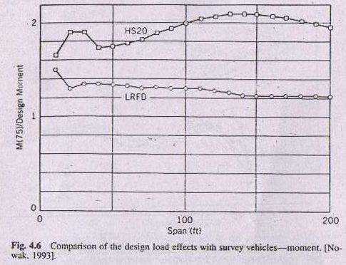
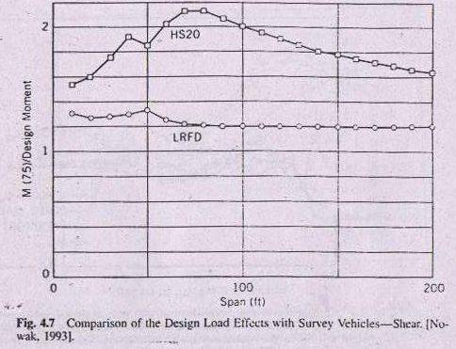
COMPARISON OF HS20 & PRESENT TRAFFIC
Nowak (1993) compared survey vehicles with others in the same lane to the AASHTO load model and the results are shown in the figure.

Slide 28
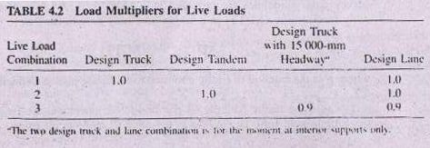
COMPARISON OF HS20 & PRESENT TRAFFIC
In summary three design loads should be considered , the design truck, design tandem and design lane. These loads are superimposed three ways to yield the live load effects , which are combined with the other load effects as shown in tables.
The above mentioned three cases are illustrated in the table where the number in the table indicate the appropriate multiplier to be used prior to superposition.

Slide 29
FATIGUE LOADS
A bridge is vulnerable to repeated stressing or fatigue.
When the load is cyclic the stress level is below the nominal yield strength.
This load depends upon:
Range of live load stress
Number of stress cycles under service load conditions.

Slide 30
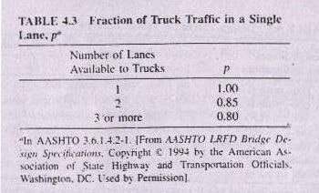
FATIGUE LOADS
Under service load conditions, majority of trucks do not exceed the legal weight limit. So it would be unnecessary to use the full live load model. Instead it is accommodated by using a single design truck with the variable axle spacing of 9m and a load factor of 0.75 as prescribed in table.[A3.4.1.1].
The number of stress load cycles is based on traffic surveys. In lieu of survey data, guidelines are provided in AASHTO [A3.6.1.4.2]. The average daily truck traffic (ADTT) in a single lane may be estimated as
ADTT_{SL = p}(ADTT)
Where p is the fraction of traffic assumed to be in one lane as defined in table4.3.

Slide 31
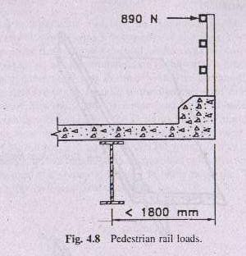
PEDESTRIAN LOADS
The AASHTO pedestrian load is 3.6 x 10⁻³ MPa, which is applied to sidewalk that are integral with a roadway bridge.
If load is applied on bridge restricted to pedestrian or bicycle traffic , then a 4.1 x 10⁻³ MPa is used.
The railing for pedestrian or bicycle must be designed for a load of 0.73 N/mm both transversely and vertically on each longitudinal element in the railing system.[A13.8 and A18.9].
In addition as shown in the figure , the railing must be designed to sustain a single concentrated load of 890 N applied to the top rail in any direction and at any location.

Slide 32
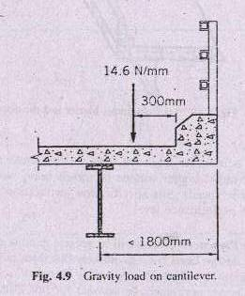
DECK & RAILING LOAD
The deck must be designed for the load effect due to design truck or design tandem , whichever creates the most extreme effect.
The deck overhang, located outside the facia girder and commonly referred to as the cantilever is designed for the load effect of a uniform line load of 14.6 N/mm located 3m from the face of the curb or railing as shown in the figure.
The gravity load for the deign of deck system are outlined in AASHTO[A3.6.1.3.3].
The vehicular gravity loads for decks may be found in AASHTO [A3.6.1.3].

Slide 33
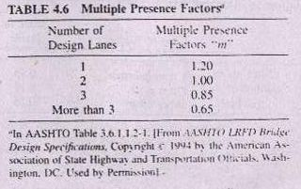
MULTIPLE PRESENCE
Trucks will be present in adjacent lanes on roadways with multiple design lanes but it is unlikely that three adjacent lanes will be loaded simultaneously with the three heavy loads.
Therefore, some adjustment in the design load is necessary. To account for this effect AASHTO [A3.6.1.1.2] provides an adjustment factor for the multiple presence. A table for these factors is provided.

Slide 34
DYNAMIC EFFECTS
Dynamics : The variation of any function with respect to time.
Dynamic Effects : The effects i.e., deformation or stress resultant due to the dynamic loads.
Due to the roughness of the road, the oscillation of the suspension system of a vehicle creates axle forces. These forces are produced by alternate compression and tension of the suspension system.
This phenomenon which is also known as IMPACT is more precisely referred to as dynamic loading.
These axle forces exceed the static weight during the time the acceleration is upward and is less than the static weight when the acceleration is downward.

Slide 35
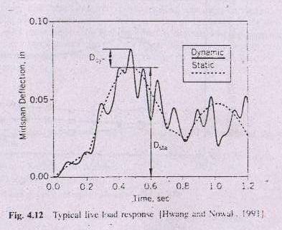
DYNAMIC EFFECTS
As the dynamic effects are not consistent & is well portrayed by Bakht & Pinjarker (1991 ) & Paultre (1992 ). It is most common to compare the static & dynamic deflection.
A comparison of static and dynamic deflections is illustrated in the fig.4.12.

Slide 36
DYNAMIC EFFECTS
From this figure dynamic effect is the amplification factor applied to the static response.
This effect is also called dynamic load factor, dynamic load allowance or impact factor and is given by,
IM = D_{dyn}
D_{stat}
Here D_{stat} is the maximum static deflection and D_{dyn} is the additional defection due to the dynamic effects.

Slide 37
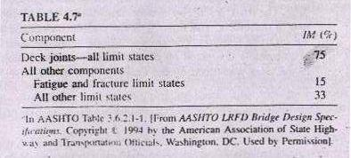
DYNAMIC EFFECTS
According to AASHTO specifications, DLA is illustrated in table 4.7[A3.6.2].

Slide 38
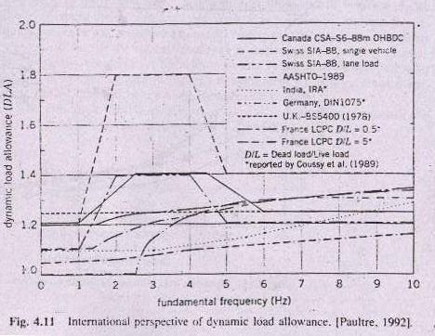
DYNAMIC EFFECTS
Paultre(1992) outlines various factors used to increase the static loads to account for dynamic load effect. The following illustration shows various bridge design specifications from around the world.

Slide 39
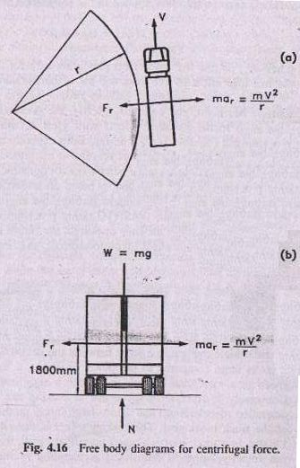
CENTRIFUGAL FORCES
As a truck moves along a curvilinear path, the change in the direction of the velocity causes a centrifugal acceleration in the radial direction. This acceleration is given by,
a_{r} = V² ….4.1
r
Where ‘ V ’ is the truck speed and ‘ r ’ is the radius of curvature of the truck movement.
Since F= ma , so substituting a_{r} in the Newton’s second law of motion,
F_{r} = m V² …..4.2
r
Where F_{r} is the force on the truck.
Since mass m = W
g

Slide 40
CENTRIFUGAL FORCES
So, we can substitute ‘ m ‘ in eq.4.2 to obtain an expression similar to that given by AASHTO,
F_{r} = V² W
rg
F_{r} = CW
Where C = 4 v²
3 Rg
Here v is the highway design speed(m/s), R is the radius of the curvature of traffic lane(m), and F is applied at the assumed centre of mass at a distance 1800 mm above the deck surface.[A3.6.3]
Because the combination of design truck with the design lane load gives a load approximately four thirds of the effect of the design truck considered independently, a four third factor is used to model the effect of a train of trucks.
Multiple presence factor may be applied to this force as it is unlikely that all the lanes will be fully loaded simultaneously.

Slide 41
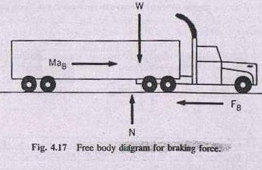
BRAKING FORCES
Braking forces are significant in bridge loads consideration. This force is transmitted to the deck and taken into the substructure by the bearings or supports.
This force is assumed to act horizontally at 1800 mm above the roadway surface in either longitudinal direction.
Here , the multiple presence factor may be applied as it is unlikely that all the trucks in all the lanes will be at the maximum design level.
The braking force shall be taken as 25% of the axle weights of the design truck or the design tandem placed in all lanes.

Slide 42
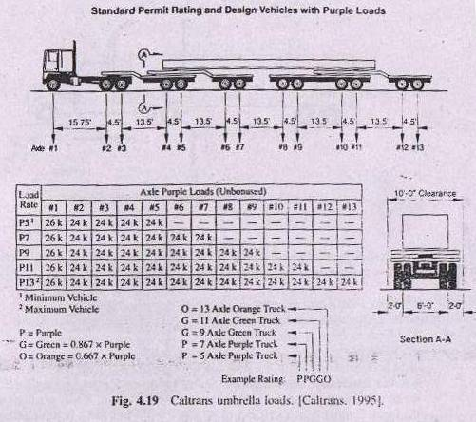
PERMIT VEHICLES AND MISCELLANEOUS CONSIDERATIONS
Transportation agencies may include vehicle loads to model characteristics of their particular jurisdiction.
For example the Department of Transportation in California (Caltrans) uses a different load model for their structures as shown in the fig.4.19.
In all such cases, the characteristics of truck loads should be based on survey data. If such data is not available or achievable, then professional judgment should be used.

Slide 43
LATERAL LOADS
Following forces are considered under lateral loads:
Fluid forces
Seismic Loads
Ice Forces

Slide 44
FLUID FORCES
Fluid forces include
Water forces and
Wind forces.
The force on a structural component due to a fluid flow (water or air) around a component is established by Bernoulli’s equation in combination with empirically established drag coefficients.

Slide 45
WIND FORCES
The velocity of the wind varies with the elevation above the ground and the upstream terrain roughness and that is why pressure on a structure is also a function of these parameters.
If the terrain is smooth then the velocity increases more rapidly with elevation.
The wind force should be considered from all directions and extreme values are used for design.
Directional adjustments are outlined in AASHTO[A3.8.1.4].
The wind must also be considered on the vehicle.This load is 1.46 N/mm applied at 1.8 m above the roadway surface.[A3.8.1.3].

Slide 46
WATER FORCES
Water flowing against and around the substructure creates a lateral force directly on the structure as well as debris that might accumulate under the bridge.
If the substructure is oriented at an angle to the stream flow, then adjustments must be made. These adjustments are outlined in the AASHTO [A3.7.3.2].
Scour of the stream bed around the foundation should also be considered as it can result in the structural failure. AASHTO [A2.6.4.4.1] outlines an extreme limit state for design.

Slide 47
SEISMIC LOADS
Depending on the location of the bridge site, the anticipated earthquake/seismic effects can govern the design of the lateral load resistance system.
In many cases the seismic loads are not critical and other lateral loads such as wind govern the design.

Slide 48
PROVISIONS FOR SEISMIC LOADS
The provision of the AASHTO specifications for seismic design are based on the following principles[C3.10.1]:
Small to moderate earthquakes should be resisted within the elastic range of the structural components without significant damage.
Realistic seismic ground motion intensities and forces are used in the design procedures.
Exposure to shaking from large earthquakes should not cause collapse of all or part of the bridge. Where possible damage should be readily detectable and accessible for inspection and repair.

Slide 49
ICE FORCES
Forces produced by ice must be considered when a structural component of a bridge, such as a pier, is located in water and the climate is cold enough to cause the water to freeze.
Due to the freeze up and break up of ice in different seasons ice forces are produced.
These are generally static which can be horizontal when caused by thermal expansion and contraction or vertical if the body of water is subject to changes in water level.
Relevant provisions are given in AASHTO section 3.9.

Slide 50
FORCES DUE TO DEFORMATION
In bridge we have to consider the following forces due to deformation:
1. Temperature
2. Creep and Shrinkage
3. Settlement

Slide 51
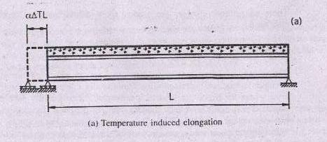
TEMPERATURE
Two types of temperature changes must be included in the analysis of the superstructure.
Uniform temperature change
Gradient or non-uniform temperature change
Uniform temperature change:
In this type of temperature change, the entire superstructure changes temperature by a constant amount. This type of change lengthens or shortens the bridge or if the supports are constrained it will induce reactions at the bearings and forces in the structure. This type of deformation is illustrated in the figure.

Slide 52
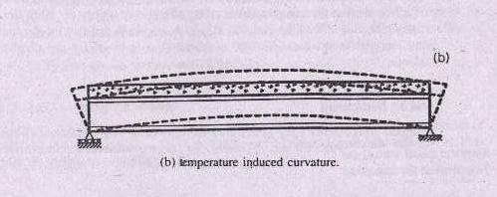
TEMPERATURE
Gradient or Non-uniform temperature change:
In this type the temperature change is gradient or non-uniform heating or cooling of the superstructure across its depth. Subjected to sunshine, bridge deck heats more than the girder below. This non-uniform heating causes the temperature to increase more in the top portion of the system than in the bottom and the girder attempts to bow upward as shown in the figure.

Slide 53
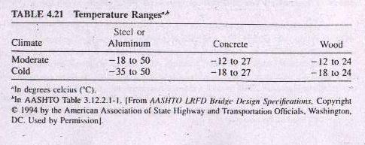
TEMPERATURE
The temperature change is considered as a function of climate. AASHTO defines two climatic conditions, moderate and cold.
Moderate climate is when the number of freezing days per year is less than 14. A freezing day is when the average temperature is less than 0°C.
Table 4.21 gives the temperature ranges. The temperature range is used to establish the change in temperature used in the analysis.

Slide 54
CREEP & SHRINKAGE
The effects of creep and shrinkage can have an effect on the structural strength, fatigue and serviceability.
Creep is considered in concrete where its effects can lead unanticipated serviceability problems that might lead to secondary strength.
Creep and shrinkage are highly dependent on material and the system involved.

Slide 55
SETTLEMENT
Settlements occur usually due to elastic and inelastic deformation of the foundation.
Elastic deformation include movements that affect the response of the bridge to other loads but do not lock in permanent actions.
This type of settlement is not a load but rather a support characteristic that should be included in the structural design.
Inelastic deformations are movements that tend to be permanent and create locked in permanent actions.

Slide 56
SETTLEMENT
Such movements may include settlement due to consolidation, instabilities, or foundation failures. Some such movements are the results are the loads applied to the bridge and these load effects may be included in the bridge design.
Other movements are attributed to the behavior of the foundation independent of the loads applied to the bridge.
These movements are treated as loads and are called imposed support deformations.
Imposed support deformations are estimated based on the geotechnical characteristics of the site and the system involved. Detailed suggestions are given in AASHTO, section 10.

Slide 57
COLLISION LOADS
Collision loads include:
Vessel Collision load
Rail Collision Load
Vehicle Collision Load

Slide 58
COLLISION LOADS
Vessel Collision load:
On bridge over navigable waterways the possibility of vessel collision with the pier must be considered. Typically, this is of concern for structures that are classified as long span bridges. Vessel collision loads are classified in AASHTO [A3.14].
Rail Collision Load:
If a bridge is located near a railway, the possibility of collision of the bridge as a result of a railway derailment exists. As this possibility is remote, the bridge must be designed for collision forces using extreme limit states.
Vehicle Collision Load:
The collision force of a vehicle with the barrier, railing and parapet should be considered in bridge design.

Slide 59
LECTURE No.2
SECTION 2
Development of Design Procedures
ASD and LRFD Design Philosophies
Limit States:
    Service Limit State
    Strength Limit State
    Fatigue and Fracture Limit State
    Extreme Event Limit State
Principles of Probabilistic Design
Geometric Design Considerations
Relevant Portions of AASHTO And PCPHB

Slide 60
DEVELOPMENT OF DESIGN PROCEDURES
DESIGN PHILOSOPHY:
It is not economical to design a bridge so that none of its components could ever fail.
It is necessary to establish an acceptable level of risk or probability of failure.
To determine an acceptable margin of safety, opinions should be sought from experienced and qualified group of engineers.
Design procedures have been developed by engineers to provide an satisfactory margin of safety.

Slide 61
DESIGN PHILOSOPHY
A general statement for assuring safety in engineering design is that
Resistance (of material & x-section) ≥ Effect of applied load
When applying this principle ,it is essential that both sides of inequality are evaluated for the same condition. For example if the effect of the applied load is to produce compressive stress on soil, then it should be compared with bearing capacity of soil.

Slide 62
DEVELOPMENT OF DESIGN PROCEDURES
Two distinct procedures employed by engineers are:
Allowable stress Design (ASD)
Load & Resistance Factor Design (LRFD)

Slide 63
ALLOWABLE STRESS DESIGN
Safety in the design was obtained by specifying that the effect of the load should produce stresses that were a fraction of the yield stress fy, say one-half. This value will be equivalent to providing a safety factor of two,i.e.,
F.O.S = Resistance,R = fy = 2
Effect of load, Q 0.5fy
Since the specification set limits on the stresses , so this became known as allowable stress design.

Slide 64
ALLOWABLE STRESS DESIGN
For steel bridge design, the required net area of a tension member is selected by :
required A_{net} = effect of the load = T
allowable stress f_{t}
For compression members, the required area is given by :
required A_{gross} = effect of the load = C
allowable stress f_{c}
For beams in bending, a required section modulus ‘S’ is determined as :
required S = effect of the load = M
allowable stress f_{b}

Slide 65
SHORTCOMINGS OF ALLOWABLE STRESS DESIGN
ASD is not suited for design of modern structures due to the following shortcomings:
The resistance concept is based on the elastic behavior of homogeneous materials.
It does not give reasonable measure of strength which is more fundamental measure of resistance than as allowable stress.
The safety factor is applied only to the resistance and loads are considered to be deterministic (i.e., without variation).
Selection of a safety factor is subjective and it doesnot provide a measure of reliability interms of probability of failure.

Slide 66
LOAD & RESISTANCE FACTOR DESIGN
To overcome the deficiencies of ASD, the LRFD method was developed which is based on
The strength of material
Consider variability not only in resistance but also in the effect of loads.
Provide a measure of safety related to probability of failure.
Thus the safety criteria is:
ΦRn ≥ η Σ γ Q_{i}
Where Φ is the resistance factor, Rn is the nominal resistance, γ is the statistically based load factor and Qi is the effect of load and η is the load modification factor.
This equation involves both load factors and resistance factors.

Slide 67
LOAD & RESISTANCE FACTOR DESIGN
In the general equation for LRFD method of design
ΦRn ≥ η Σ γi Qi
η is the load modification factor that takes into its account the ductility, redundancy and operational importance of the bridge.It is given by the expression
η = η_{d} η_{r} η_{i} ≥ 0.95
Where η_{d} is the ductility factor, η_{r} is the redundancy factor and η_{i} is the operational importance factor.

Slide 68
DUCTILITY FACTOR
Ductility Factor:
Ductility is important to the safety of the bridge.
If ductility is present overloaded portion of the structure can redistribute the load to other portions that have reserve strength.
This redistribution is dependent on the ability of the overloaded component and its connections to develop inelastic deformations without failure.
Brittle behavior is to be avoided, because it implies a sudden loss of load carrying capacity when the elastic limit is exceeded.
The value to be used for the strength limit state, ductility factors are
η_{d} = 1.05 for non-ductile components and connections
η_{d} = 0.95 for ductile components and connections

Slide 69
REDUNDANCY FACTOR
Redundancy Factor:
A statically indeterminate structure is redundant, that is, it has more restraints than necessary to satisfy conditions of equilibrium.
For example, a three span continuous bridge girder would be classified as statically indeterminate to second degree. Any combination of two supports or two moments or one support and one moment could be lost without immediate collapse, because the loads could find alternative paths to the ground.
Redundancy in a bridge system will increase its margin of safety and this is reflected in the strength limit state redundancy factors given as
η_{R} = 1.05 for non-redundant members
η_{R} = 0.95 for redundant members

Slide 70
OPERATIONAL IMPORTANCE FACTOR
Operational Importance Factor:
Bridges can be considered of operational importance if they are on the shortest path between residential areas and a hospital or a school or provide access for police, fire, and rescue vehicles to homes, businesses, industrial plants, etc.
It is difficult to find a situation where a bridge would not be operationally important.
One example of a non important bridge could be on a secondary road leading to a remote recreation area, that is not open year around.
In the event of an earthquake, it is important that all lifelines, such as bridges remain open. Therefore, following requirements apply to the extreme event limit state as well as to the strength limit state.
η_{i} = 1.05 for non-ductile components and connections
η_{i} = 0.95 for ductile components and connections
For all other limit states: η_{i} = 1.0

Slide 71
ADVANTAGES OF LRFD
LRFD accounts for both variability in resistance and load
It achieves fairly uniform factor of safety for different limit states.
It provides a rationale and consistent method of design.

Slide 72
DISADVANTAGES OF LRFD
It requires a change in design philosophy (from previous AASHTO methods).
It requires an understanding of the basic concepts of probability and statistics.
It requires availability of sufficient statistical data and probabilistic design algorithms to make adjustments in the resistance factors to meet individual situation.

Slide 73
LOAD COMBINATIONS & LOAD FACTORS
Load Factor: “A factor accounting for the variability of loads, the lack of accuracy in analysis and the probability of simultaneous occurrence of different loads.
The load factors for various load combinations and permanent loads are given in the table 3.1 and 3.2 respectively.

Slide 74
LOAD COMBINATION TABLE (AASHTO TABLE 3.4.1-1)
Load Combination Limit State | DC DD DW EH EV ES | LCE BR PL LS | WA | WS | WL | FR | TU CR SH | TG | SE | Use one of these at a time
 |  |  |  |  |  |  |  |  |  | EQ | IC | CT | CV
STRENGTH – I | γ_{p} | 1.75 | 1.00 | - | - | 1.00 | 0.50/1.20 | γ_{TG} | γ_{SE} | - | - | - | -
STRENGTH - II | γ_{p} | 1.35 | 1.00 | - | - | 1.00 | 0.50/1.20 | γ_{TG} | γ_{SE} | - | - | - | -
STRENGTH - III | γ_{p} | - | 1.00 | 1.40 | - | 1.00 | 0.50/1.20 | γ_{TG} | γ_{SE} | - | - | - | -
STRENGTH – IV EH, EV, ES, DW, DC ONLY | γ_{p} _{1.5} | - | 1.00 | - | - | 1.00 | 0.50/1.20 | - | - | - | - | - | -
STRENGTH – V | γ_{p} | 1.35 | 1.00 | 0.40 | 0.40 | 1.00 | 0.50/1.20 | γ_{TG} | γ_{SE} | - | - | - | -
EXTREME EVENT – I | γ_{p} | γ_{EQ} | 1.00 | - | - | 1.00 | - | - | - | 1.00 | - | - | -
EXTREME EVENT – II | γ_{p} | 0.50 | 1.00 | - | - | 1.00 | - | - | - | - | 1.00 | 1.00 | 1.00
SERVICE - I | 1.00 | 1.00 | 1.00 | 0.30 | 0.30 | 1.00 | 1.00/1.20 | γ_{TG} | γ_{SE} | - | - | - | -
SERVICE – II | 1.00 | 1.30 | 1.00 | - | - | 1.00 | 1.00/1.20 | - | - | - | - | - | -
SERVICE - III | 1.00 | 0.80 | 1.00 | - | - | 1.00 | 1.00/1.20 | γ_{TG} | γ_{SE} | - | - | - | -
FATIGUE – LL, IM, AND CE ONLY | - | 0.75 | - | - | - | - | - | - | - | - | - | - | -
Back

Slide 75
LOAD FACTORS FOR PERMANENT LOADS,
(AASHTO table 3.4.1-2)
Type of Load | Use One of These at a Time
 | Maximum | Minimum
DC: Component and Attachments | 1.25 | 0.90
DD: Downdrag | 1.80 | 0.45
DW: Wearing Surfaces and Utilities | 1.50 | 0.65
EH: Horizontal Earth Pressure Active At-Rest | 1.50 1.35 | 0.90 0.90
EV: Vertical Earth Pressure Overall Stability Retaining Structure Rigid Buried Structure Rigid Frames Flexible Buried Structures other than Metal Box Culverts Flexible Metal Box Culverts | 1.35 1.35 1.30 1.35 1.95 1.50 | N/A 1.00 0.90 0.90 0.90 0.90
ES: Earth Surcharge | 1.50 | 0.75
Back

Slide 76
LIMIT STATES
Limit State:
“A limit state is a condition beyond which a structural system or structural component ceases to fulfill the function for which it is designed”.
Bridges shall be designed for specified limit states to achieve the objectives of constructability, safety and serviceability.
Generally the limit states that are considered in bridge design are:
Service limit state
Fatigue and fracture limit state
Strength limit state
Extreme Event limit state

Slide 77
SERVICE LIMIT STATE
This limit state refers to restrictions on stresses, deflections and crack widths of bridge components that occur under regular service conditions.[A1.3.2.2]
For the limit state the resistance factors Φ = 1.0 and nearly all the load factors γ_{i} are equal to 1.0.
There are three service limit conditions given in the table to cover different design situations.

Slide 78
LOAD COMBINATION TABLE (AASHTO TABLE 3.4.1-1)
Load Combination Limit State | DC DD DW EH EV ES | LCE BR PL LS | WA | WS | WL | FR | TU CR SH | TG | SE | Use one of these at a time
 |  |  |  |  |  |  |  |  |  | EQ | IC | CT | CV
STRENGTH – I | γ_{p} | 1.75 | 1.00 | - | - | 1.00 | 0.50/1.20 | γ_{TG} | γ_{SE} | - | - | - | -
STRENGTH - II | γ_{p} | 1.35 | 1.00 | - | - | 1.00 | 0.50/1.20 | γ_{TG} | γ_{SE} | - | - | - | -
STRENGTH - III | γ_{p} | - | 1.00 | 1.40 | - | 1.00 | 0.50/1.20 | γ_{TG} | γ_{SE} | - | - | - | -
STRENGTH – IV EH, EV, ES, DW, DC ONLY | γ_{p} _{1.5} | - | 1.00 | - | - | 1.00 | 0.50/1.20 | - | - | - | - | - | -
STRENGTH – V | γ_{p} | 1.35 | 1.00 | 0.40 | 0.40 | 1.00 | 0.50/1.20 | γ_{TG} | γ_{SE} | - | - | - | -
EXTREME EVENT – I | γ_{p} | γ_{EQ} | 1.00 | - | - | 1.00 | - | - | - | 1.00 | - | - | -
EXTREME EVENT – II | γ_{p} | 0.50 | 1.00 | - | - | 1.00 | - | - | - | - | 1.00 | 1.00 | 1.00
SERVICE - I | 1.00 | 1.00 | 1.00 | 0.30 | 0.30 | 1.00 | 1.00/1.20 | γ_{TG} | γ_{SE} | - | - | - | -
SERVICE – II | 1.00 | 1.30 | 1.00 | - | - | 1.00 | 1.00/1.20 | - | - | - | - | - | -
SERVICE - III | 1.00 | 0.80 | 1.00 | - | - | 1.00 | 1.00/1.20 | γ_{TG} | γ_{SE} | - | - | - | -
FATIGUE – LL, IM, AND CE ONLY | - | 0.75 | - | - | - | - | - | - | - | - | - | - | -
Back

Slide 79
SERVICE LIMIT STATE
Service I:
This service limit state refers to the load combination relating to the normal operational use of the bridge with 90 km/h wind.
Service II:
This service limit state refers to the load combination relating only to steel structures and is intended to control yielding and slip of slip critical connections.
Service III:
This service limit state refers to the load combination relating only to tension in pre-stressed concrete structures with the objective of crack control.

Slide 80
FATIGUE AND FRACTURE LIMIT STATE
This limit state refers to restrictions on stress range caused by a design truck.
The restrictions depend upon the stress range excursions expected to occur during the design life of the bridge.[A1.3.2.3].
This limit state is used to limit crack growth under repetitive loads and to prevent fracture due to cumulative stress effects in steel elements, components, and connections.
For the fatigue and fracture limit state, Φ = 1.0
Since, the only load that causes a large number of repetitive cycles is the vehicular live load, it is the only load effect that has a non-zero load factor in the table 3.1

Slide 81
LOAD COMBINATION TABLE (AASHTO TABLE 3.4.1-1)
Load Combination Limit State | DC DD DW EH EV ES | LCE BR PL LS | WA | WS | WL | FR | TU CR SH | TG | SE | Use one of these at a time
 |  |  |  |  |  |  |  |  |  | EQ | IC | CT | CV
STRENGTH – I | γ_{p} | 1.75 | 1.00 | - | - | 1.00 | 0.50/1.20 | γ_{TG} | γ_{SE} | - | - | - | -
STRENGTH - II | γ_{p} | 1.35 | 1.00 | - | - | 1.00 | 0.50/1.20 | γ_{TG} | γ_{SE} | - | - | - | -
STRENGTH - III | γ_{p} | - | 1.00 | 1.40 | - | 1.00 | 0.50/1.20 | γ_{TG} | γ_{SE} | - | - | - | -
STRENGTH – IV EH, EV, ES, DW, DC ONLY | γ_{p} _{1.5} | - | 1.00 | - | - | 1.00 | 0.50/1.20 | - | - | - | - | - | -
STRENGTH – V | γ_{p} | 1.35 | 1.00 | 0.40 | 0.40 | 1.00 | 0.50/1.20 | γ_{TG} | γ_{SE} | - | - | - | -
EXTREME EVENT – I | γ_{p} | γ_{EQ} | 1.00 | - | - | 1.00 | - | - | - | 1.00 | - | - | -
EXTREME EVENT – II | γ_{p} | 0.50 | 1.00 | - | - | 1.00 | - | - | - | - | 1.00 | 1.00 | 1.00
SERVICE - I | 1.00 | 1.00 | 1.00 | 0.30 | 0.30 | 1.00 | 1.00/1.20 | γ_{TG} | γ_{SE} | - | - | - | -
SERVICE – II | 1.00 | 1.30 | 1.00 | - | - | 1.00 | 1.00/1.20 | - | - | - | - | - | -
SERVICE - III | 1.00 | 0.80 | 1.00 | - | - | 1.00 | 1.00/1.20 | γ_{TG} | γ_{SE} | - | - | - | -
FATIGUE – LL, IM, AND CE ONLY | - | 0.75 | - | - | - | - | - | - | - | - | - | - | -
Back

Slide 82
STRENGTH LIMIT STATE
This limit state refers to providing sufficient strength or resistance to satisfy the inequality
ΦRn ≥ η Σ γi Qi
This limit state include the evaluation of resistance to bending, shear, torsion, and axial load.
The statically determined resistance factor Φ will be less than 1.0 and will have values for different materials and strength limit states.

Slide 83
STRENGTH LIMIT STATE
Strength-I:
This strength limit is the basic load combination relating to the normal vehicular use of the bridge without wind.
Strength-II:
This strength limit is the basic load combination relating to the use of the bridge by permit vehicles without wind.
Strength-III:
This strength limit is the basic load combination relating to the bridge exposed to wind velocity exceeding 90 km/h.

Slide 84
LOAD COMBINATION TABLE (AASHTO TABLE 3.4.1-1)
Load Combination Limit State | DC DD DW EH EV ES | LCE BR PL LS | WA | WS | WL | FR | TU CR SH | TG | SE | Use one of these at a time
 |  |  |  |  |  |  |  |  |  | EQ | IC | CT | CV
STRENGTH – I | γ_{p} | 1.75 | 1.00 | - | - | 1.00 | 0.50/1.20 | γ_{TG} | γ_{SE} | - | - | - | -
STRENGTH - II | γ_{p} | 1.35 | 1.00 | - | - | 1.00 | 0.50/1.20 | γ_{TG} | γ_{SE} | - | - | - | -
STRENGTH - III | γ_{p} | - | 1.00 | 1.40 | - | 1.00 | 0.50/1.20 | γ_{TG} | γ_{SE} | - | - | - | -
STRENGTH – IV EH, EV, ES, DW, DC ONLY | γ_{p} _{1.5} | - | 1.00 | - | - | 1.00 | 0.50/1.20 | - | - | - | - | - | -
STRENGTH – V | γ_{p} | 1.35 | 1.00 | 0.40 | 0.40 | 1.00 | 0.50/1.20 | γ_{TG} | γ_{SE} | - | - | - | -
EXTREME EVENT – I | γ_{p} | γ_{EQ} | 1.00 | - | - | 1.00 | - | - | - | 1.00 | - | - | -
EXTREME EVENT – II | γ_{p} | 0.50 | 1.00 | - | - | 1.00 | - | - | - | - | 1.00 | 1.00 | 1.00
SERVICE - I | 1.00 | 1.00 | 1.00 | 0.30 | 0.30 | 1.00 | 1.00/1.20 | γ_{TG} | γ_{SE} | - | - | - | -
SERVICE – II | 1.00 | 1.30 | 1.00 | - | - | 1.00 | 1.00/1.20 | - | - | - | - | - | -
SERVICE - III | 1.00 | 0.80 | 1.00 | - | - | 1.00 | 1.00/1.20 | γ_{TG} | γ_{SE} | - | - | - | -
FATIGUE – LL, IM, AND CE ONLY | - | 0.75 | - | - | - | - | - | - | - | - | - | - | -
Back

Slide 85
STRENGTH LIMIT STATE
Strength-IV:
This strength limit is the basic load combination relating to very high dead load/live load force effect ratios.
Strength-V:
This strength limit is the basic load combination relating to the normal vehicular use of the bridge with wind of 90 km/h velocity. It differs from the Strength-III limit state by the presence of the live load on the bridge, wind on the live load and reduced wind on the structure.

Slide 86
EXTREME EVENT LIMIT STATE
This load effect refers to the structural survival of a bridge during a major earthquakes or floods or when collided by a vessel, vehicle, or ice flow[A1.3.2.5].
These loads are specified to be applied separately, as the probability of these events occurring simultaneously is very low.

Slide 87
LOAD COMBINATION TABLE (AASHTO TABLE 3.4.1-1)
Load Combination Limit State | DC DD DW EH EV ES | LCE BR PL LS | WA | WS | WL | FR | TU CR SH | TG | SE | Use one of these at a time
 |  |  |  |  |  |  |  |  |  | EQ | IC | CT | CV
STRENGTH – I | γ_{p} | 1.75 | 1.00 | - | - | 1.00 | 0.50/1.20 | γ_{TG} | γ_{SE} | - | - | - | -
STRENGTH - II | γ_{p} | 1.35 | 1.00 | - | - | 1.00 | 0.50/1.20 | γ_{TG} | γ_{SE} | - | - | - | -
STRENGTH - III | γ_{p} | - | 1.00 | 1.40 | - | 1.00 | 0.50/1.20 | γ_{TG} | γ_{SE} | - | - | - | -
STRENGTH – IV EH, EV, ES, DW, DC ONLY | γ_{p} _{1.5} | - | 1.00 | - | - | 1.00 | 0.50/1.20 | - | - | - | - | - | -
STRENGTH – V | γ_{p} | 1.35 | 1.00 | 0.40 | 0.40 | 1.00 | 0.50/1.20 | γ_{TG} | γ_{SE} | - | - | - | -
EXTREME EVENT – I | γ_{p} | γ_{EQ} | 1.00 | - | - | 1.00 | - | - | - | 1.00 | - | - | -
EXTREME EVENT – II | γ_{p} | 0.50 | 1.00 | - | - | 1.00 | - | - | - | - | 1.00 | 1.00 | 1.00
SERVICE - I | 1.00 | 1.00 | 1.00 | 0.30 | 0.30 | 1.00 | 1.00/1.20 | γ_{TG} | γ_{SE} | - | - | - | -
SERVICE – II | 1.00 | 1.30 | 1.00 | - | - | 1.00 | 1.00/1.20 | - | - | - | - | - | -
SERVICE - III | 1.00 | 0.80 | 1.00 | - | - | 1.00 | 1.00/1.20 | γ_{TG} | γ_{SE} | - | - | - | -
FATIGUE – LL, IM, AND CE ONLY | - | 0.75 | - | - | - | - | - | - | - | - | - | - | -
Back

Slide 88
EXTREME EVENT LIMIT STATE
Extreme Event -I:
This extreme event limit state is the load combination relating to earthquake. This limit state also include water load and friction.
Extreme Event -I:
This extreme event limit state is the load combination to ice load, collision by vessels, vehicles and to certain hydraulic events with reduced live loads.

Slide 89
LOAD COMBINATION TABLE (AASHTO TABLE 3.4.1-1)
Load Combination Limit State | DC DD DW EH EV ES | LCE BR PL LS | WA | WS | WL | FR | TU CR SH | TG | SE | Use one of these at a time
 |  |  |  |  |  |  |  |  |  | EQ | IC | CT | CV
STRENGTH – I | γ_{p} | 1.75 | 1.00 | - | - | 1.00 | 0.50/1.20 | γ_{TG} | γ_{SE} | - | - | - | -
STRENGTH - II | γ_{p} | 1.35 | 1.00 | - | - | 1.00 | 0.50/1.20 | γ_{TG} | γ_{SE} | - | - | - | -
STRENGTH - III | γ_{p} | - | 1.00 | 1.40 | - | 1.00 | 0.50/1.20 | γ_{TG} | γ_{SE} | - | - | - | -
STRENGTH – IV EH, EV, ES, DW, DC ONLY | γ_{p} _{1.5} | - | 1.00 | - | - | 1.00 | 0.50/1.20 | - | - | - | - | - | -
STRENGTH – V | γ_{p} | 1.35 | 1.00 | 0.40 | 0.40 | 1.00 | 0.50/1.20 | γ_{TG} | γ_{SE} | - | - | - | -
EXTREME EVENT – I | γ_{p} | γ_{EQ} | 1.00 | - | - | 1.00 | - | - | - | 1.00 | - | - | -
EXTREME EVENT – II | γ_{p} | 0.50 | 1.00 | - | - | 1.00 | - | - | - | - | 1.00 | 1.00 | 1.00
SERVICE - I | 1.00 | 1.00 | 1.00 | 0.30 | 0.30 | 1.00 | 1.00/1.20 | γ_{TG} | γ_{SE} | - | - | - | -
SERVICE – II | 1.00 | 1.30 | 1.00 | - | - | 1.00 | 1.00/1.20 | - | - | - | - | - | -
SERVICE - III | 1.00 | 0.80 | 1.00 | - | - | 1.00 | 1.00/1.20 | γ_{TG} | γ_{SE} | - | - | - | -
FATIGUE – LL, IM, AND CE ONLY | - | 0.75 | - | - | - | - | - | - | - | - | - | - | -
Back

Slide 90
PRINCIPLES OF PROBABALISTIC DESIGN
This is a review to understand the basic concepts of statistics and probability.
Probabilistic analysis are not necessary to apply the LRFD method in practice except for rare situations that are not included by the code.
The following section define and discuss the statistical and probabilistic terms .

Slide 91
PRINCIPLES OF PROBABALISTIC DESIGN
This section includes :
  Sample, Mean, Mode, Median, Midrange
  Standard deviation
  Probability density function
  Bias factor
  Coefficient of variation
  Probability of failure

Slide 92
Sample and Sample Size
A sample is a set of values which may be discrete or continuous.
Sample size is the total number of elements in a sample and is referred by ‘n’.

Slide 93
Mean Value
The sum of all elements of the data set divided by the number of elements.
x = Σ x_{i} / n
___

Slide 94
Mode
It is the data element which occurs most frequently. For example, in a sample having
elements 1,3,4,3,5,7, the mode is ‘3’.
Empty Mode set
If there is no repeated value in a sample, there is no mode for this sample or the mode is
said to have an empty set.
Bi-modal Data
If two elements (values) are repeated for equal number of times within a sample
then the sample data is said to be bimodal.
Multi-modal Data
If more than two elements (values) are repeated for equal number of times within a sample
then the sample data is said to be multi-modal.

Slide 95
Median
Median is the middle element in a data set when the set is arranged in order of magnitude.
For example, for a data set 3, 4, 2, 7, 9, 13, 1
the median is 4.
1, 2, 3, 4, 7, 9, 13

Slide 96
Mid Range
Midrange is the arithmetic mean of the highest and lowest data element.
For example, for a data set 3, 4, 2, 7, 9, 13, 1
the Midrange is calculated as:
Midrange = (x_{max}+ x_{min}) / 2
So, Midrange = (1+ 13) / 2 = 7

Slide 97

Please Remember:
Mean, Median and Midrange always exist
and are unique.
Mode may or may not be unique and even
may not exist at all.

Slide 98
Dispersion of Data
Dispersion of data is the measure of each element as to how far it is from some measure of central tendency (average).
There are several ways to measure the dispersion of the data.
Some are:
1. Range
2. Standard Deviation
3. Variance

Slide 99
Range
Range is the difference between the highest and the lowest element.
Range is a measure of dispersion of the data set.
For example, for a data set 3, 4, 2, 7, 9, 13, 1 the
range is calculated as:
Range = (x_{max}- x_{min})
So, Range = (13 - 1) = 12

Slide 100
Standard Deviation
This is the most common and useful measure to determine the dispersion of data because it is the average distance of each score (element or value) from the mean.
Standard deviation of a data set is often used by scientists as a measure of the precision to which an experiment has been done.
Also, it can indicate the reproducibility of the result.
That is the probability of the outcomes to occur.

Slide 101
Standard Deviation
Standard deviation is measured as:
Σ ( x – x_{i} )²
σ =
n - 1
σ = Standard Deviation
X = Mean
Xi = Any specific element
n = Size of sample (total number of elements)

Slide 102
Variance
Variance is the square of the standard deviation.
It is the third method of measuring dispersion of
data.
Conventionally, Statisticians use Variance while scientists use Standard Deviation to determine dispersion.

Slide 103
Variance
Variance is measured as:
Σ ( x – x_{i} )²
v =
n - 1
v = variance
X = Mean
Xi = Any specific element
n = Size of sample (total number of elements)

Slide 104
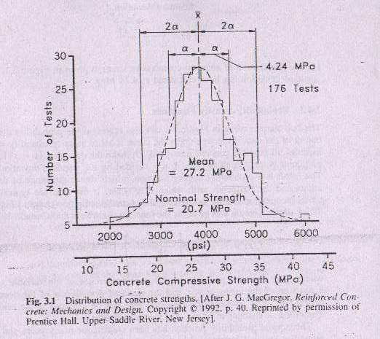
Bell Shape Distribution Function
As the name implies, it is a bell shaped figure obtained by approximating a histogram drawn for a sample set.
The is done by joining the tops of the ordinate values of a histogram with the help of a curve.
HISTOGRAM
It is the graphical representation of frequency distribution.

Slide 105
Bell Shape Distribution Function
Consider a histogram of 28 day compressive strength distribution of 176 concrete cylinders, all intended to provide a design strength of 20.7 MPa. In this case the number of times a particular compressive strength (1.38 MPa) intervals was observed.

Slide 107
Probability Distribution Functions
The symmetrical histogram in the previous figure represents the frequency distributions graphically.
The same histogram can be used to represent the probability distribution of the data if the area under the curve is set to ‘1’.

Slide 108
Probability Density Functions
Probability density function is the probability distribution function obtained from the histogram constructed in the case of continuous data (values).

Slide 109
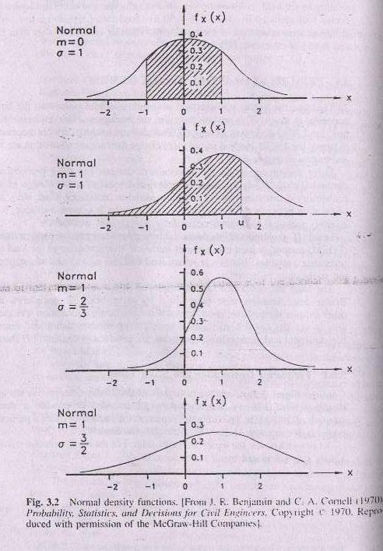

Slide 110
Bias Factor
Bias factor is the ratio of the mean value to the nominal value.
i.e, λ = x / x_{n}

Slide 111
Coefficient of Variation
To provide a measure of dispersion, it is convenient to define a value that is expressed as a fraction or percentage of the mean value.
The most common measure of dispersion is
coefficient of variation
i.e, V = σ / x

Slide 112
Probability of Failure
Failure is defined as the realization of one of a number of pre-defined limit states.
The probability of failure can be determined if the mean and standard deviations of the resistance and load distribution functions are known.

Slide 113
Probability of Failure
Consider the probability density functions for the random variables of load Q and Resistance density functions for a hypothetical example limit state.
As long as the resistance R is greater than the effects of the load Q, there is a margin of safety for the limit state under consideration.

Slide 114
Probability of Failure
Probability of Survival,
p_{s} = P (R > Q)
Probability of Failure,
p_{f} = 1- P (R < Q)

Slide 115
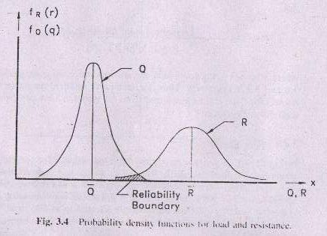
Probability of Failure

Slide 116
GEOMETRIC DESIGN CONSIDERATIONS
When two highways intersect at a grade separation or interchange, the geometric design of the intersection will often determine the span lengths and selection of bridge type.
The bridge engineer must be aware of the design elements that the highway engineer considers to be important.
The document that gives the geometric standards is ‘A Policy Of The Geometric Design Of Highways And Streets, AASHTO(1994a)’.
Roadway width and vertical clearance are discussed in the following sections.

Slide 117
ROADWAY WIDTH
When traffic is crossing over a bridge there should not be a sense of restriction.
To avoid a sense of restriction, requires that the roadway on the bridge be the same as that of the approaching highway.

Slide 118
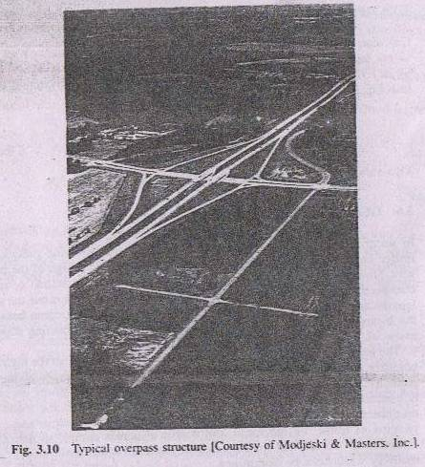
ROADWAY WIDTH
A typical overpass structure of a four lane divided freeway crossing a secondary road is shown in the figure below.

Slide 119
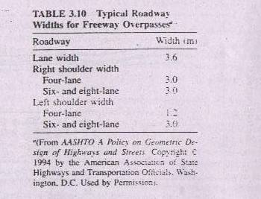
ROADWAY WIDTH
The recommended minimum width of shoulders and traffic lanes for the roadway on the bridge are given in the table below.

Slide 120
VERTICAL CLEARANCES
For bridge over highways, the vertical clearances are given by ‘A Policy on Geometric Design of Highways and Streets(AASHTO 1994a)[A2.3.3.2]
For freeways and arterial systems a minimum vertical clearance is 4.9 m plus an allowance for several resurfacing of about150 mm.
In general , a desired minimum vertical clearance of all structures above the traveled way and shoulders is 5m.

Slide 121
Thank you all for attending the lecture

Slide 122
LOAD COMBINATION TABLE (AASHTO TABLE 3.4.1-1)
Load Combination Limit State | DC DD DW EH EV ES | LCE BR PL LS | WA | WS | WL | FR | TU CR SH | TG | SE | Use one of these at a time
 |  |  |  |  |  |  |  |  |  | EQ | IC | CT | CV
STRENGTH – I | γ_{p} | 1.75 | 1.00 | - | - | 1.00 | 0.50/1.20 | γ_{TG} | γ_{SE} | - | - | - | -
STRENGTH - II | γ_{p} | 1.35 | 1.00 | - | - | 1.00 | 0.50/1.20 | γ_{TG} | γ_{SE} | - | - | - | -
STRENGTH - III | γ_{p} | - | 1.00 | 1.40 | - | 1.00 | 0.50/1.20 | γ_{TG} | γ_{SE} | - | - | - | -
STRENGTH – IV EH, EV, ES, DW, DC ONLY | γ_{p} _{1.5} | - | 1.00 | - | - | 1.00 | 0.50/1.20 | - | - | - | - | - | -
STRENGTH – V | γ_{p} | 1.35 | 1.00 | 0.40 | 0.40 | 1.00 | 0.50/1.20 | γ_{TG} | γ_{SE} | - | - | - | -
EXTREME EVENT – I | γ_{p} | γ_{EQ} | 1.00 | - | - | 1.00 | - | - | - | 1.00 | - | - | -
EXTREME EVENT – II | γ_{p} | 0.50 | 1.00 | - | - | 1.00 | - | - | - | - | 1.00 | 1.00 | 1.00
SERVICE - I | 1.00 | 1.00 | 1.00 | 0.30 | 0.30 | 1.00 | 1.00/1.20 | γ_{TG} | γ_{SE} | - | - | - | -
SERVICE – II | 1.00 | 1.30 | 1.00 | - | - | 1.00 | 1.00/1.20 | - | - | - | - | - | -
SERVICE - III | 1.00 | 0.80 | 1.00 | - | - | 1.00 | 1.00/1.20 | γ_{TG} | γ_{SE} | - | - | - | -
FATIGUE – LL, IM, AND CE ONLY | - | 0.75 | - | - | - | - | - | - | - | - | - | - | -
Back

Slide 123
LOAD FACTORS FOR PERMANENT LOADS,
(AASHTO table 3.4.1-2)
Type of Load | Use One of These at a Time
 | Maximum | Minimum
DC: Component and Attachments | 1.25 | 0.90
DD: Downdrag | 1.80 | 0.45
DW: Wearing Surfaces and Utilities | 1.50 | 0.65
EH: Horizontal Earth Pressure Active At-Rest | 1.50 1.35 | 0.90 0.90
EV: Vertical Earth Pressure Overall Stability Retaining Structure Rigid Buried Structure Rigid Frames Flexible Buried Structures other than Metal Box Culverts Flexible Metal Box Culverts | 1.35 1.35 1.30 1.35 1.95 1.50 | N/A 1.00 0.90 0.90 0.90 0.90
ES: Earth Surcharge | 1.50 | 0.75
Back

Slide 124
LOAD COMBINATION TABLE (AASHTO TABLE 3.4.1-1)
Load Combination Limit State | DC DD DW EH EV ES | LCE BR PL LS | WA | WS | WL | FR | TU CR SH | TG | SE | Use one of these at a time
 |  |  |  |  |  |  |  |  |  | EQ | IC | CT | CV
STRENGTH – I | γ_{p} | 1.75 | 1.00 | - | - | 1.00 | 0.50/1.20 | γ_{TG} | γ_{SE} | - | - | - | -
STRENGTH - II | γ_{p} | 1.35 | 1.00 | - | - | 1.00 | 0.50/1.20 | γ_{TG} | γ_{SE} | - | - | - | -
STRENGTH - III | γ_{p} | - | 1.00 | 1.40 | - | 1.00 | 0.50/1.20 | γ_{TG} | γ_{SE} | - | - | - | -
STRENGTH – IV EH, EV, ES, DW, DC ONLY | γ_{p} _{1.5} | - | 1.00 | - | - | 1.00 | 0.50/1.20 | - | - | - | - | - | -
STRENGTH – V | γ_{p} | 1.35 | 1.00 | 0.40 | 0.40 | 1.00 | 0.50/1.20 | γ_{TG} | γ_{SE} | - | - | - | -
EXTREME EVENT – I | γ_{p} | γ_{EQ} | 1.00 | - | - | 1.00 | - | - | - | 1.00 | - | - | -
EXTREME EVENT – II | γ_{p} | 0.50 | 1.00 | - | - | 1.00 | - | - | - | - | 1.00 | 1.00 | 1.00
SERVICE - I | 1.00 | 1.00 | 1.00 | 0.30 | 0.30 | 1.00 | 1.00/1.20 | γ_{TG} | γ_{SE} | - | - | - | -
SERVICE – II | 1.00 | 1.30 | 1.00 | - | - | 1.00 | 1.00/1.20 | - | - | - | - | - | -
SERVICE - III | 1.00 | 0.80 | 1.00 | - | - | 1.00 | 1.00/1.20 | γ_{TG} | γ_{SE} | - | - | - | -
FATIGUE – LL, IM, AND CE ONLY | - | 0.75 | - | - | - | - | - | - | - | - | - | - | -
Back

Slide 125
LOAD FACTORS FOR PERMANENT LOADS,
(AASHTO table 3.4.1-2)
Type of Load | Use One of These at a Time
 | Maximum | Minimum
DC: Component and Attachments | 1.25 | 0.90
DD: Downdrag | 1.80 | 0.45
DW: Wearing Surfaces and Utilities | 1.50 | 0.65
EH: Horizontal Earth Pressure Active At-Rest | 1.50 1.35 | 0.90 0.90
EV: Vertical Earth Pressure Overall Stability Retaining Structure Rigid Buried Structure Rigid Frames Flexible Buried Structures other than Metal Box Culverts Flexible Metal Box Culverts | 1.35 1.35 1.30 1.35 1.95 1.50 | N/A 1.00 0.90 0.90 0.90 0.90
ES: Earth Surcharge | 1.50 | 0.75
Back

